Slide 1

Process Mining Virtual Internship
by
G Vamsi Krishna
Roll No. 224G5A3214
Department of Computer Science and Engineering (Data Science)
Srinivasa Ramanujan Institute of Technology
(Affiliated to JNTUA & Approved by AICTE) (Accredited by NAAC with ‘A’ Grade & Accredited by NBA (EEE, ECE & CSE)
Rotarypuram Village, B K Samudram Mandal, Ananthapuramu – 515701.
2023 - 2024

Slide 2

Contents
Course Objective
Introduction
Technology
Applications
Modules
Real Time applications
Learning outcomes
GitHub Link
Queries

Slide 3
Course Objective
The main objectives of Process Mining are to identify patterns, discover relationships, and uncover insights that can be used to improve decision-making.
Process Mining is the technology at the heart of the Celonis Execution Management System(EMS). enabling enterprises to fully understand how their core business processes run and find the hidden value opportunities, before taking intelligent, automated action to improve performance and unlock hundreds of millions across the enterprises.

Slide 4
Introduction
What is Process Mining?
Process Mining is the combination of two disciplines: Data Science and Business Process Management. Process Mining essentially uses Data Science techniques, such as Big Data and AI, to address Process Science problems such as process improvement and automation.
It encompasses several techniques that help organizations analyze event data and gain insights into their business processes. These techniques enable organizations to discover, understand, and improve their processes.
Process Mining is an analytical discipline for discovering, monitoring, and improving processes as they are Process Mining works by extracting knowledge from event logs (also called digital footprints) readily available in today’s information systems, to visualize business processes and their variations.

Slide 5
Technology
To analyze the track processes
Process mining applies data science to discover, validate and improve workflows.
Tool that quickly analyzes all of your process data from various systems like an ERP, CRM or MES
Process mining, like any other data-driven analysis approach, needs to deal with data quality problems. A data source may be a simple flat file, an Excel spreadsheet, a transaction log, or a database table
Database systems are used for storing and managing event logs, which are converted into process models.
Technologies to extract, transform, and load event data from various IT systems within an organization.

Slide 6
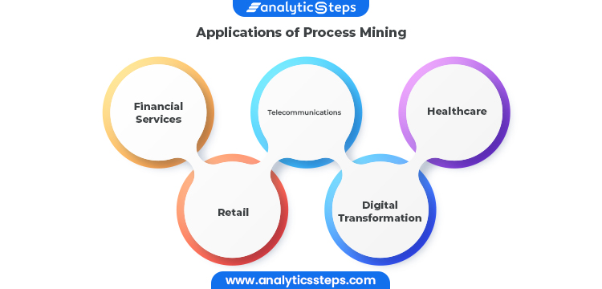
Applications
Financial services, telecommunications, healthcare, and retail are just a few examples of industries where process mining can be used for business process management and process improvement. These sectors have a wealth of data that can be used as a starting point, and process deviations from their intended behavior can have expensive repercussions.

Slide 7
Financial Services:
Because of the rise in transaction volume and the digitization of more industries, aberrant activity is harder to detect using manual methods. Companies in the financial services sector have the chance to continually and thoroughly identify issues within high-volume processes thanks to process mining, which is a solution to the increased regulatory and audit requirements.
Telecommunications:
As subscriber quantities increase and activations become more and more automated, there is a greater danger of unsuccessful activations. When telecom companies get more orders, process mining gives them the chance to identify pricey issues and client blowback in their Order-to-Activation processes.
Healthcare:
The risks associated with preserving population health and achieving individual patient journey objectives rise as data about patient experiences and results keep growing. Process mining supports the delivery of effective and high-quality end-to-end patient journeys for healthcare organizations dealing with the exponential growth of data, from before a first doctor appointment through treatment regimens to closed treatment cases.

Slide 8
Modules
Module 1 : Introduction to Process Mining
Module 2: Fundamentals of Process Mining
Module 3: Rising Star Technical
PQL Queries
Get Data into EMS

Slide 9
Contd..
Module 1 : Introduction to Process Mining
A process is a systematic series of actions, tasks, or steps that are executed in a specific sequence to achieve a desired outcome or goal. Processes are fundamental to various fields, including business operations, manufacturing, software development, and more. They provide structure and organization to activities, ensuring that tasks are performed in an orderly and efficient manner.
Process mining has a wide range of uses across different industries and sectors. Its applications span from improving operational efficiency to ensuring compliance and driving digital transformation
Process mining uncovers opportunities to streamline or automate processes, for example, with robotic process automation (RPA).‍

Slide 10
Contd…
Implementation of Process Mining:
Identify the processes to be analyzed
Collect or integrate data
Verify data quality
Analyze the data
Interpret the results and implement changes
Monitor and adjust

Slide 11
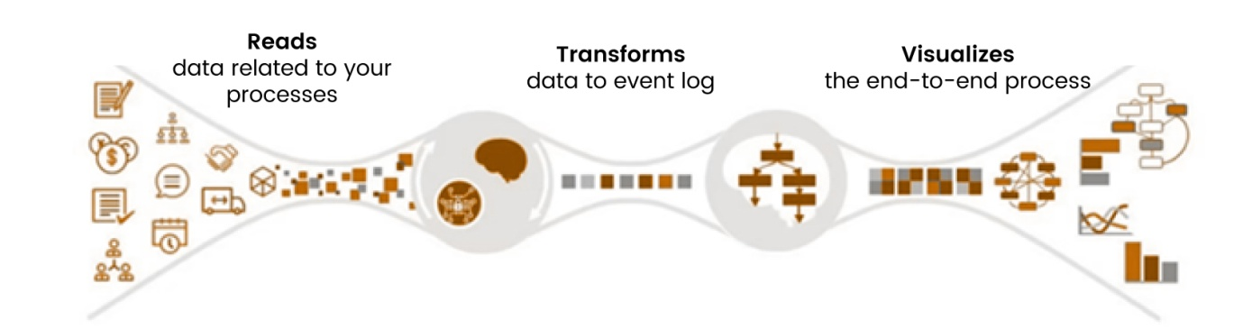
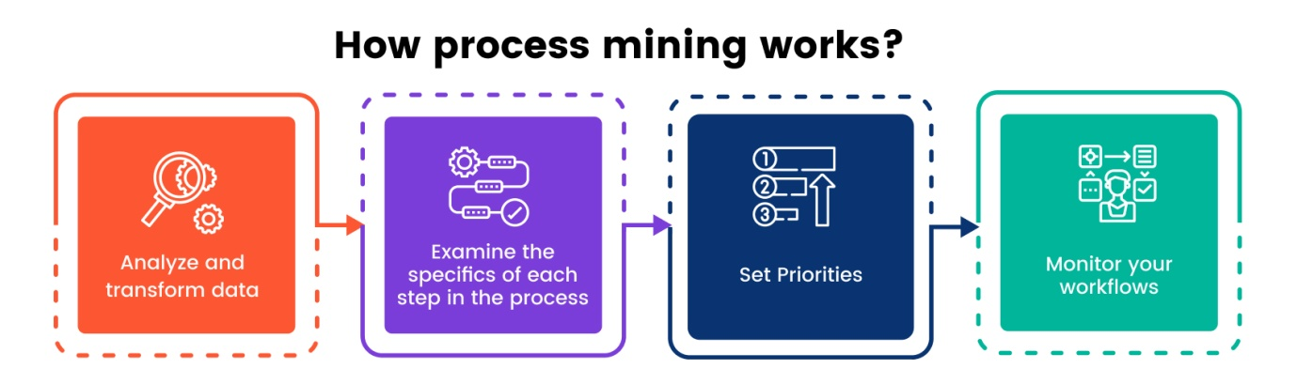
Contd…

Slide 12
Contd..
Module 2 : Fundamentals of Process Mining
The key Fundamentals of process mining refer to the core concepts and principles that underlie the analysis and improvement of business processes using process mining techniques. It involves extracting insights from event data to understand how processes function, identifying bottlenecks, inefficiencies, and opportunities for optimization.
The process mining fundamentals are :
Variant explorer
Process Explorer
Charts

Slide 13
Contd..
Variant Explorer: It is a Celonis EMS Analysis tool that helps you explore how a specific process flows through your organization.
Process Explorer: The Process Explorer is another analysis tool to use when taking an exploratory approach. It also allows you to narrow your focus on a single activity. It's especially useful for quickly revealing activities beyond the most common ones.
Charts: Data can be visualized through charts. There are multiple charts that help in data visualization.
Area
Bar
Line
Lollipop
Scatterplot

Slide 14
Contd…
Module 3 : Rising Star Technical
In this topic we will study about two types they are Set up a data pipeline
Refine your Data Pipeline
In the set up a data pipeline again divide into sub parts they are
Data Integration basics
Connect to Systems
Extract Data
Transform Data
Load a Data Model

Slide 15
Contd..
Data Integration: Data integration is the process of bringing data from disparate sources together to provide users with a unified view. The premise of data integration is to make data more freely available and easier to consume and process by systems and users.
Extract Data: Data extraction is the process of obtaining raw data from a source and replicating that data somewhere else. The raw data can come from various sources, such as a database, Excel spreadsheet, an SaaS platform, web scraping, or others. This can include unstructured data, disparate types of data, or simply data that is poorly organized
Transform data: Data transformation is used when data needs to be converted to match that of the destination system.
Data Loading: Data Loading deals with data getting loaded into a storage system, such as a cloud data warehouse. It the process of packing up your data and moving it to a designated data warehouse

Slide 16
Contd…
Celonis Process Mining
The Celonis process mining platform is called the Execution Management System (EMS). In addition to traditional process mining functionality, the EMS offers a cloud-based solution for real-time data extraction and analysis, as well as task mining functionality. Celonis EMS also includes process modeling and process simulation functionality.
Top features:
Wide adoption
Integrations
Customization
Broad user community

Slide 17
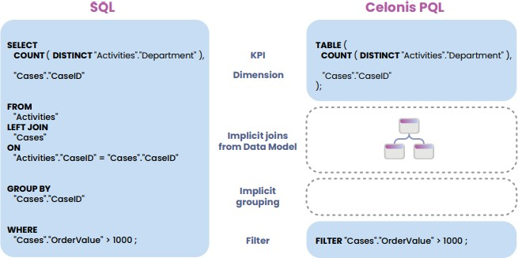
Contd…
Celonis PQL provides a wide range of different operators which can be combined to answer complex business questions. Even though Celonis PQL is inspired by SQL, there are major differences between the two query languages. On a high level, Celonis PQL varies along four key dimensions:
1. Language Scope
2. Data Manipulation Language
3. Data Definition language
4. Domain-Specific
Comparison of SQL and PQL

Slide 18
Real Time Applications
Retail: Inventory Management and Fulfillment
Healthcare: Patient Journey Analysis
Finance: Invoice Processing
Manufacturing: Production Line Efficiency
Customer Support: Helpdesk Operations
IT Service Management: Incident Handling
Logistics: Order Processing
Insurance: Claims Processing
Energy: Maintenance and Repairs

Slide 19
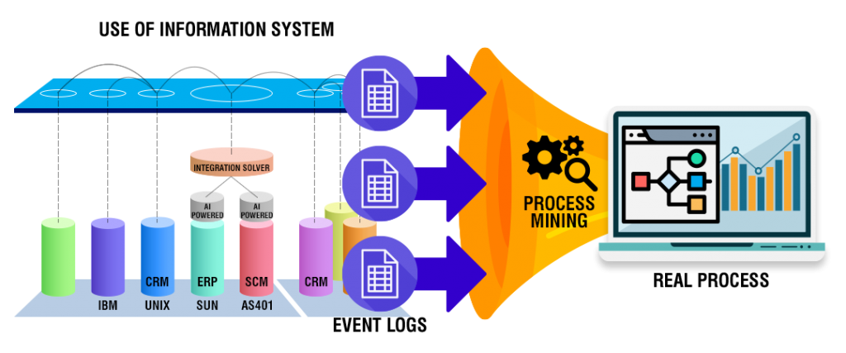
Contd…

Slide 20
Learning outcomes
Perform the basic tasks necessary to build Celonis analyses.
Become familiar with Analysis Settings and Permissions.
Publish analyses using best practices in version control.
Put your knowledge about the theoretical foundations of Process Mining into practice.
Save an analysis selection for future reference and share it with your team; export visualizations and process data.

Slide 21
Github Link

Slide 22
Any Queries?

Slide 23
Thank You!!!

